Slide 1

The significance of the existence of “Minna No Ouchi”
▮ Current state of child poverty in Japan
Do you know about the poverty state of Japanese children?
Currently, the child poverty rate in
Japan (2018) is 13.5%, and it is said that
about one in seven people live in poverty.
In addition, 48.1% of single-parent households are said to be in a state of poverty, about one in two people.

Slide 2
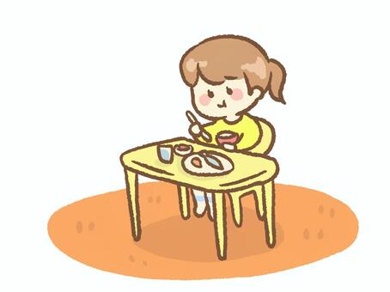
This situation is said to be the worst among developed countries.
▮ Current state of solitary eating in Japan
Do you know solitary eating?
Solitary eating literally means eating in isolation.
According to a survey, the rate of children eating dinner alone on weekdays is
1.6% for elementary school students and 3.7% for junior high school students.
At first glance it may seem like a small number, but when you multiply it by the number of students, there are about 100,000 elementary school students and
about 120,000 junior high school students.
Together, we can see that about 220,000 students are spending dinner alone nationwide.

Slide 3
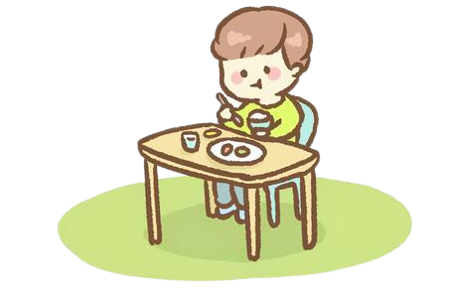
Is it only children who often eat alone?
Of course not.
According to a survey of elderly people aged 60 to 84, 11.6% of men and
19.6% of women eat alone every day.
There are so many people who have no choice but to eat alone due to various reasons such as being single, divorced, or passed away.
▮ So what is the “Minna No Ouchi” that we are aiming for?
Our goal is to create a “Minna No Ouchi” where everyone can easily get together and spend time around the dining table together, eliminating all barriers such as gender, age, nationality, and background!

Slide 4
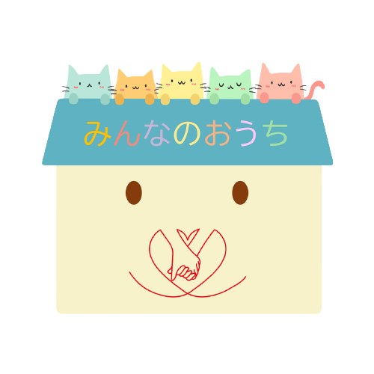
Nowadays, many people eat alone due to various reasons such as poverty, I want not only children who are unable to eat as much as they want, but also adults to spend some time around the dining table with someone!
If you usually spend time eating alone, it is difficult to communicate with someone, but if there is a place nearby where you can sit around the table with someone and have more chances to communicate, there must be something happier than spending time eating alone!

Slide 5



